Slide 1
DR6.3 API keys and OAUTH
Andrew Beatty
Andrew.Beatty@gmit.ie
Data Representation

Slide 2
Restricting access
A resource owner may want to restrict access to the resource.
  May not want anyone to:
    change data
    View sensitive data (your bank details)
  May want to limit the amount of times someone can make a request, especially if the request will take a lot of processing. E.g. searching twitter feeds.

Slide 3
API Keys
API keys exist, and can be used to provide authorisation to access resources
The resource owner can generate a key can give it to a third party, to allow the third party access to the resource.
Hotel key
In practice:
  Get a key:
    Apply for a key from the resource owner
    Log in and generate a key
  Include it in the request to access the resource
    Put it in the URL (GET) as a parameter
    Put it in the header as a attribute
Just like any other bit of data

Slide 5
Demonstration 2 Github
We saw in the last lecture that githup has an API, and used it to get public information
We can use the api get private information and make commits to the repository
  Setting => generation a API key
  Use the key in requests
  I have made a github account for this user: datarepresentationstudent
  Key: b4ddb9e5603da11cd857b83bad6ea6eb1819b92d
  More info
  https://developer.github.com/v3/
  https://developer.github.com/v3/guides/
requests.get(url, auth=('token',apiKey))

Slide 7
A bit more on OAuth
OAuth1 and OAuth2
Lots of different use-cases
2 legged
  Resource owner of a techy and can get the key from the authorisation server
3 legged
  Resource owner is not a techy, so we need to write the code to get the key from the authorisation server.
  This is beyond the scope of this course….. But worth a quick explanation
  https://auth0.com/docs/api-auth/which-oauth-flow-to-use

Slide 8
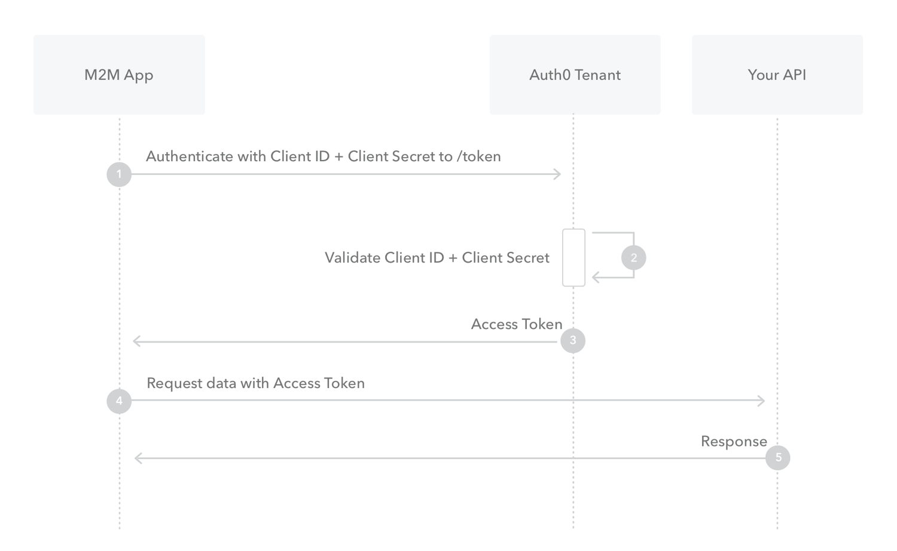

Slide 9
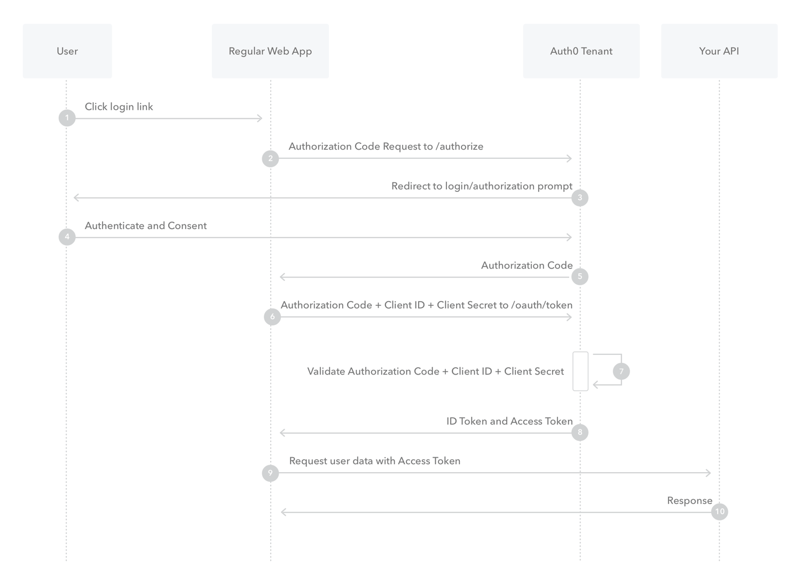

Slide 10
Conclusion
You may need keys to access the a resource
  Log on the resource server
  Get the key
  Include it in the requests

